Slide 1
Presentation on health-tech
Team Name:-Lucifer24
Team Member:-
1.Ankit Mittal
2.Munzir Nabeel
3.Siddharth Sharma

Slide 2

Problem Statement :
When a patient comes from doctor after checkup then he doesn't know that he is recovering or not and if he is not recovering what other precaution he should take. Patient can't go to the doctor everytime specially in the time of pandemic so what he should do to know what to do. For this problem he have a solution so that doctor and patient both will know that everything is under control or not and if not what to do.

Slide 3

How the Idea Will Impact present Situation
This time is going bad for the whole world because the whole world is fighting against covid19.
When the covid comes in India , at that time there was no high cases in India .so government was decided to quarantine covid positive people in some government center for 14 days. But when the case arise ,it is not possible to quarantine people some specific number of center .
So people was quarantined in their places or home. And it is not possible to go outside for checkup every day.
So how we can help them to improve their health. So we will create a web app in which people can add their daily situation and describe our health status. Then doctor will monitor your situation and give you some precautions based on your situation ,and suggest you some medicine if necessary.

Slide 4
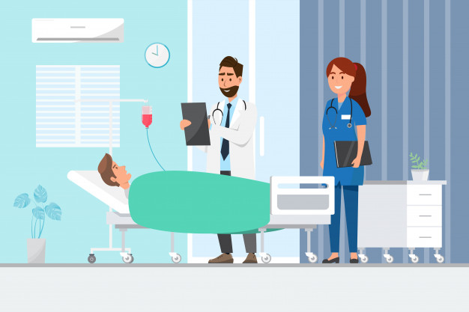
1.you will be discharged today.but take precautions for 15 days and give me status for next 15 days.
3.Health care will help you go to add status and add your status then doctor will monitoring your situation and give you suggestion what precautions you should take.
2 .How I can share you status.

Slide 5
Solution :
To solve problem we created a website for both doctors and patients. In this website patient can update their problem and difficulties he is facing to doctor. Both Patient and doctors can also track patient health status of past 15 days. By this both patient and doctor have patients past reports and medicine he is taking. By monitoring all problems doctor will suggest medicine and precautions.

Slide 6





Technologies used

Slide 7
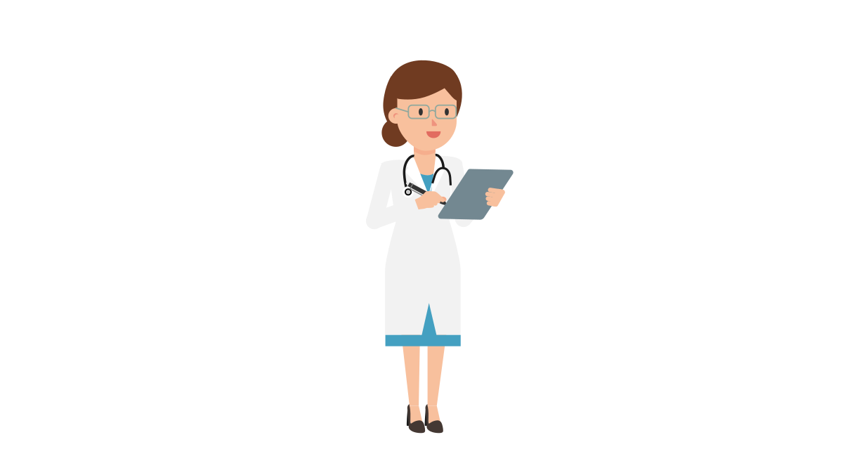
Final Website Structure
User can Add their daily status and can track their status
Doctor can track all user status and allow to give response of user queries
User can read doctor reply and take precautions based on doctor suggestions
We will add on more feature that user can track covid cases data country wise
Stay Safe, Stay Healthy

